Slide 1
Experiment-4

Slide 2


Prepared By
Bhuvnesh Sanathra
Semester-7

Slide 3
Installation of Docker Desktop

Slide 4
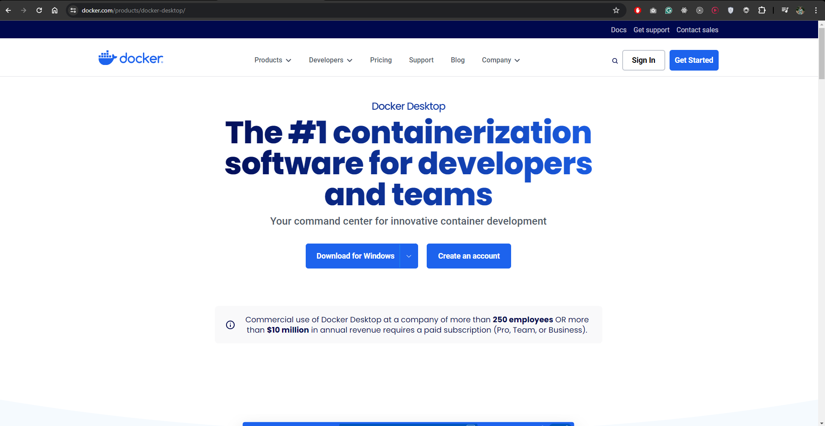
Docker Desktop Installation
For downloading the Docker Desktop visit https://www.docker.com/products/docker-desktop/
Click on Download For Windows

Slide 5
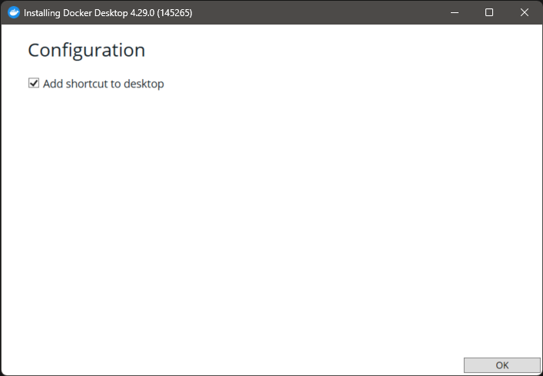
Docker Desktop Installation
Open the setup once installation is done
Click OK

Slide 6
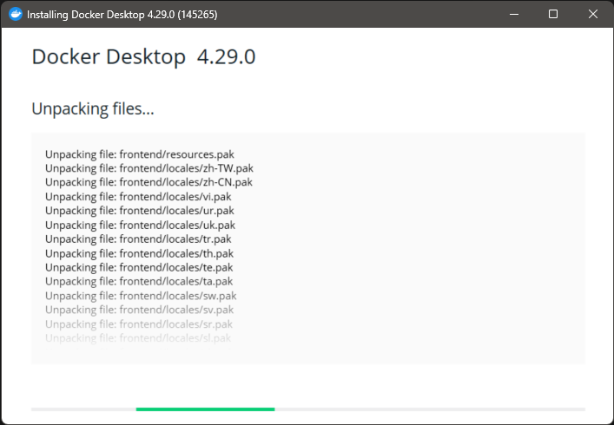
Docker Desktop Installation
Installation Started

Slide 7
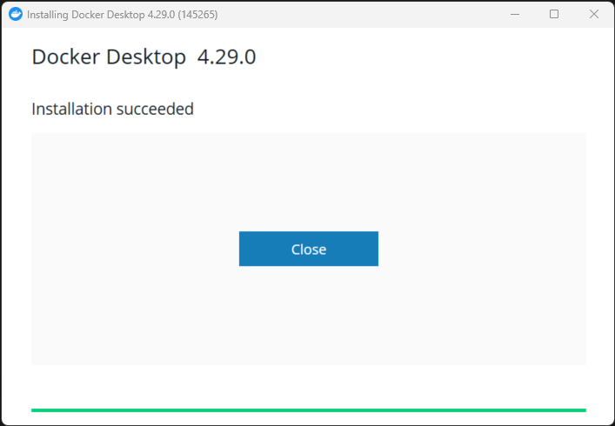
Docker Desktop Installation
Installation Done!

Slide 8
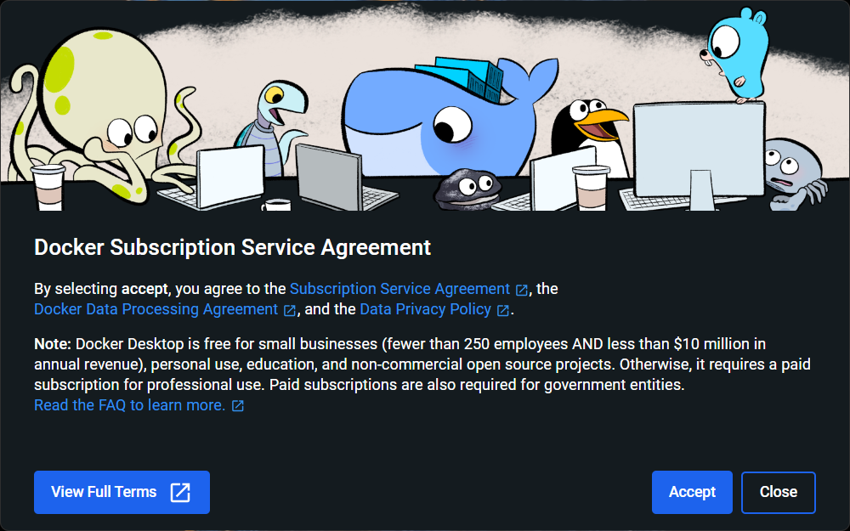
Docker Desktop Installation
Open the Docker Desktop & Accept it
Accept

Slide 9
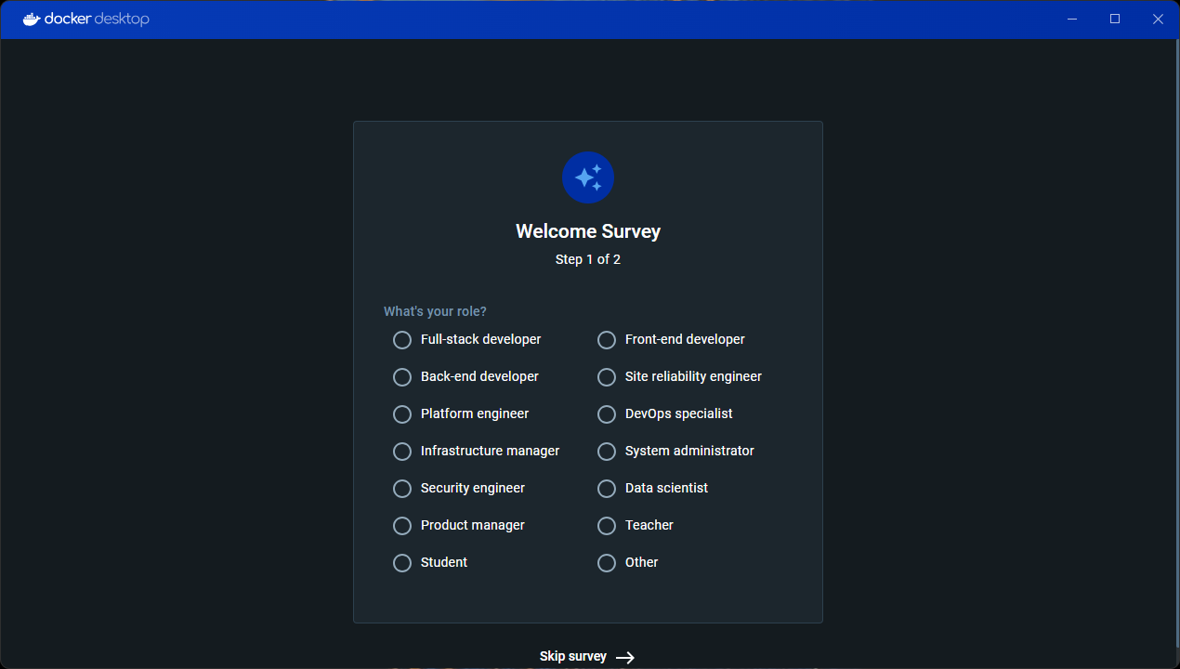
Docker Desktop Installation
If you want to perform Survey select role else Skip Survey

Slide 10
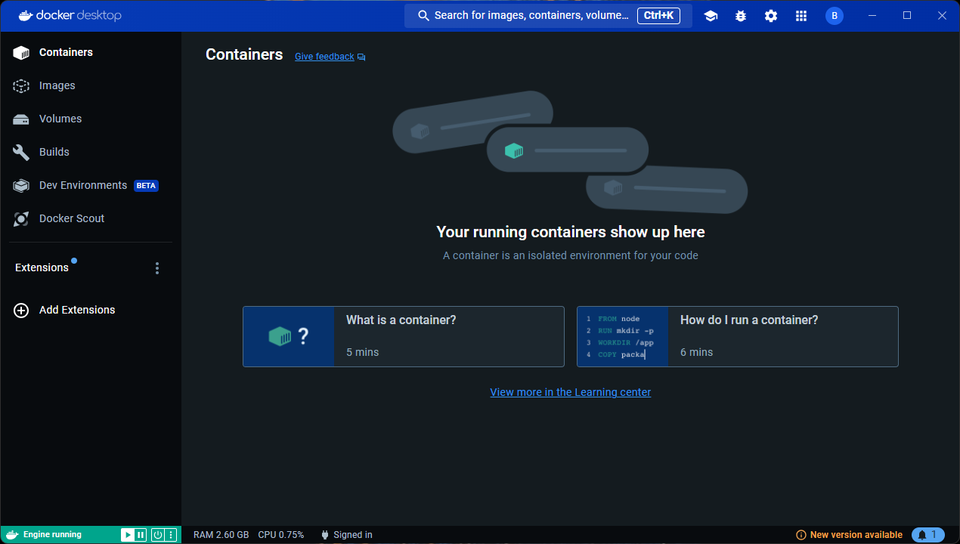
Docker Desktop Installation
Docker Desktop is installed successfully.

Slide 11
Docker

Slide 12
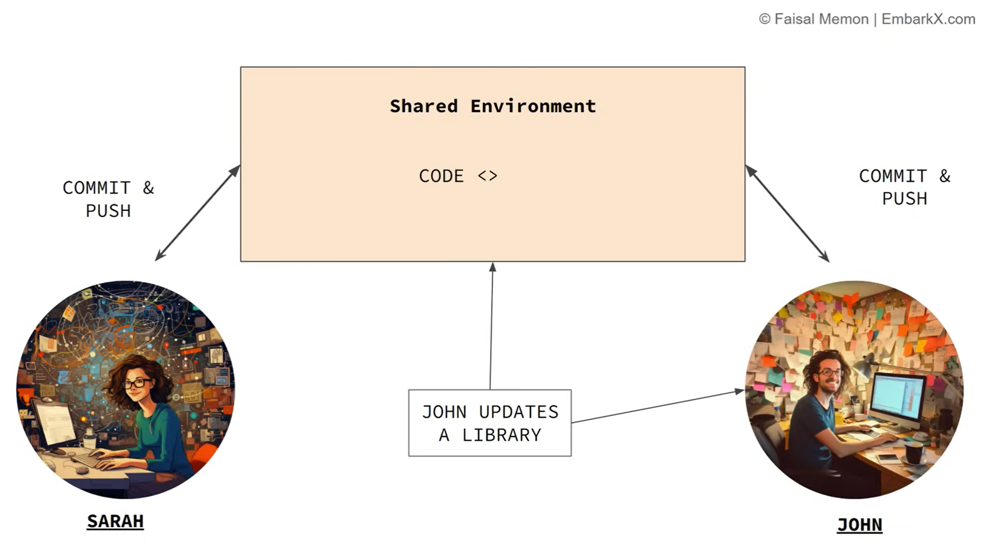
Why Docker?
2 Person are working on same code base and let say JOHN changes the Version of library used in shared Environment.
Now, it is difficult to manage the version of different user in same shared environment.

Slide 13
Why Docker?
It causes version conflict or compatibility problem.
Which then causes the inconsistency in development.
Application is working fine in one development environment but not in another developer environment.

Slide 14
What is solution to this??
Docker
HOW??

Slide 15
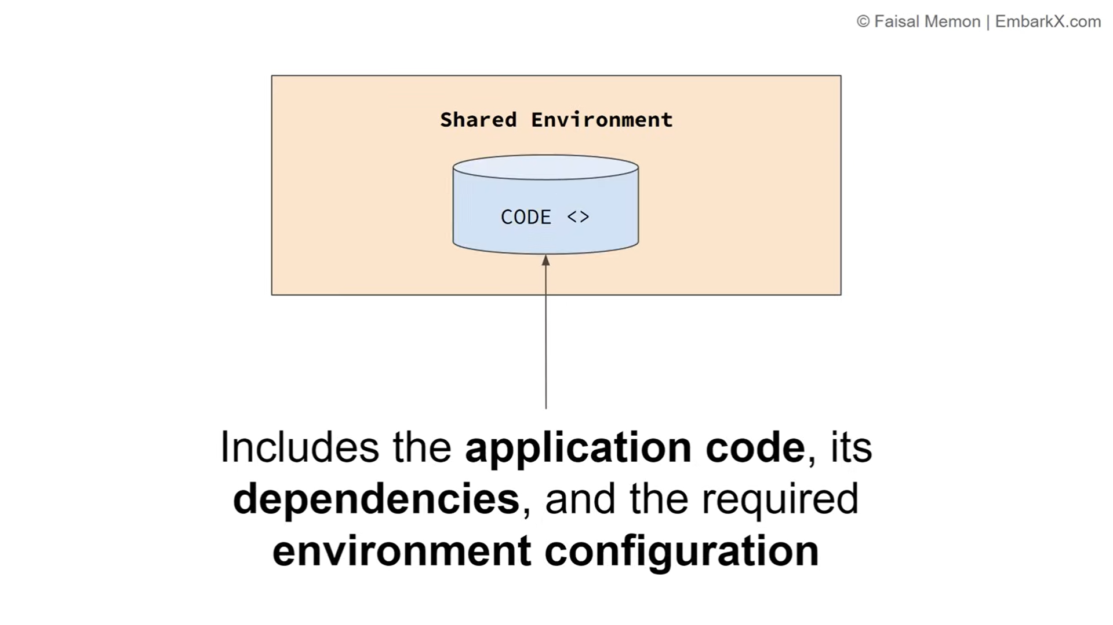
How?
Containerized the application using Docker.

Slide 16
What does it means?
Move codebase to container.
Which includes application code, dependencies, and the required environment configuration.

Slide 17
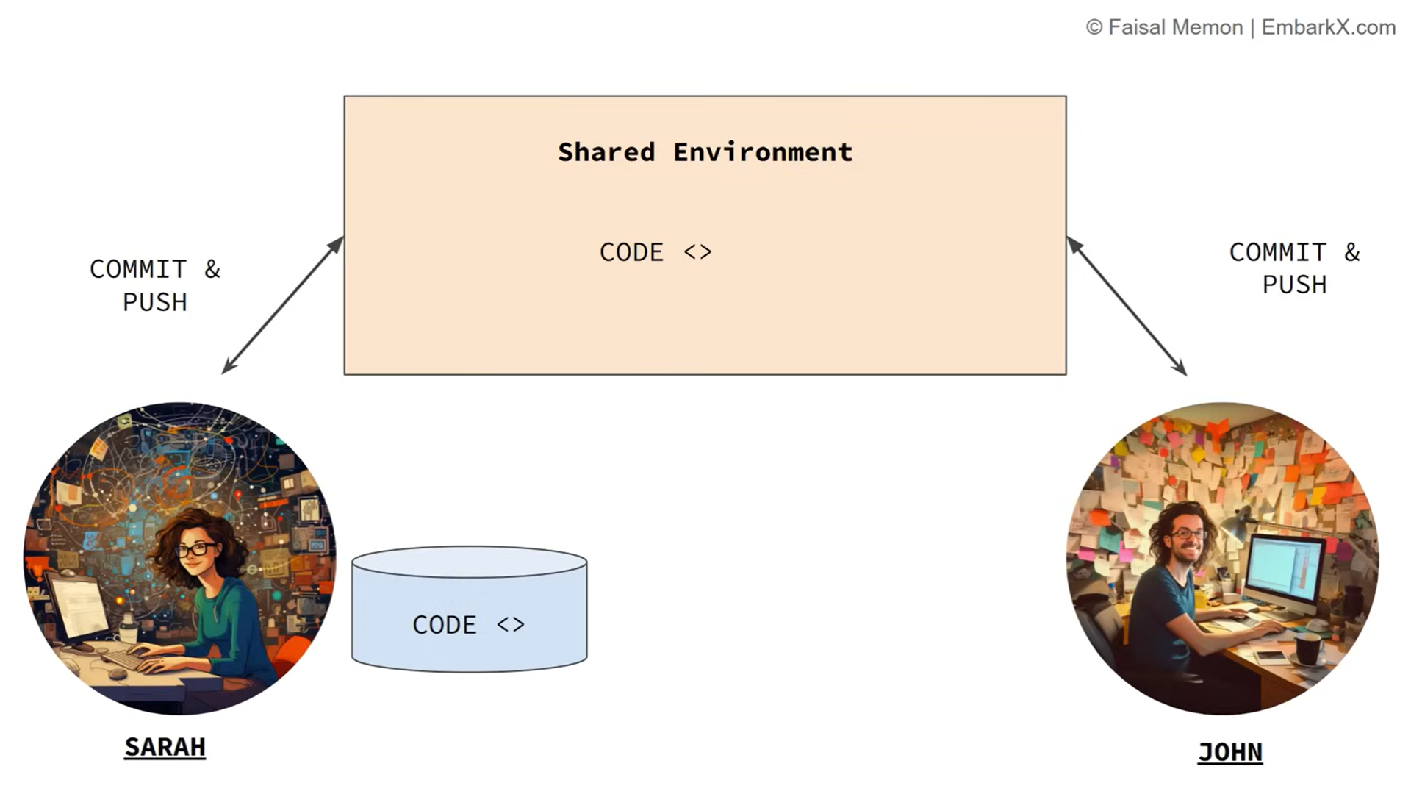
How?
SARAH will use the Docker and has the container which contains all the required environment and application is running.

Slide 18
How?
Now SARAH no need to worry about the conflicting versions or any other issues because of any versions conflicts.
Now everybody in team of SARAH will upgrade to Docker.

Slide 19
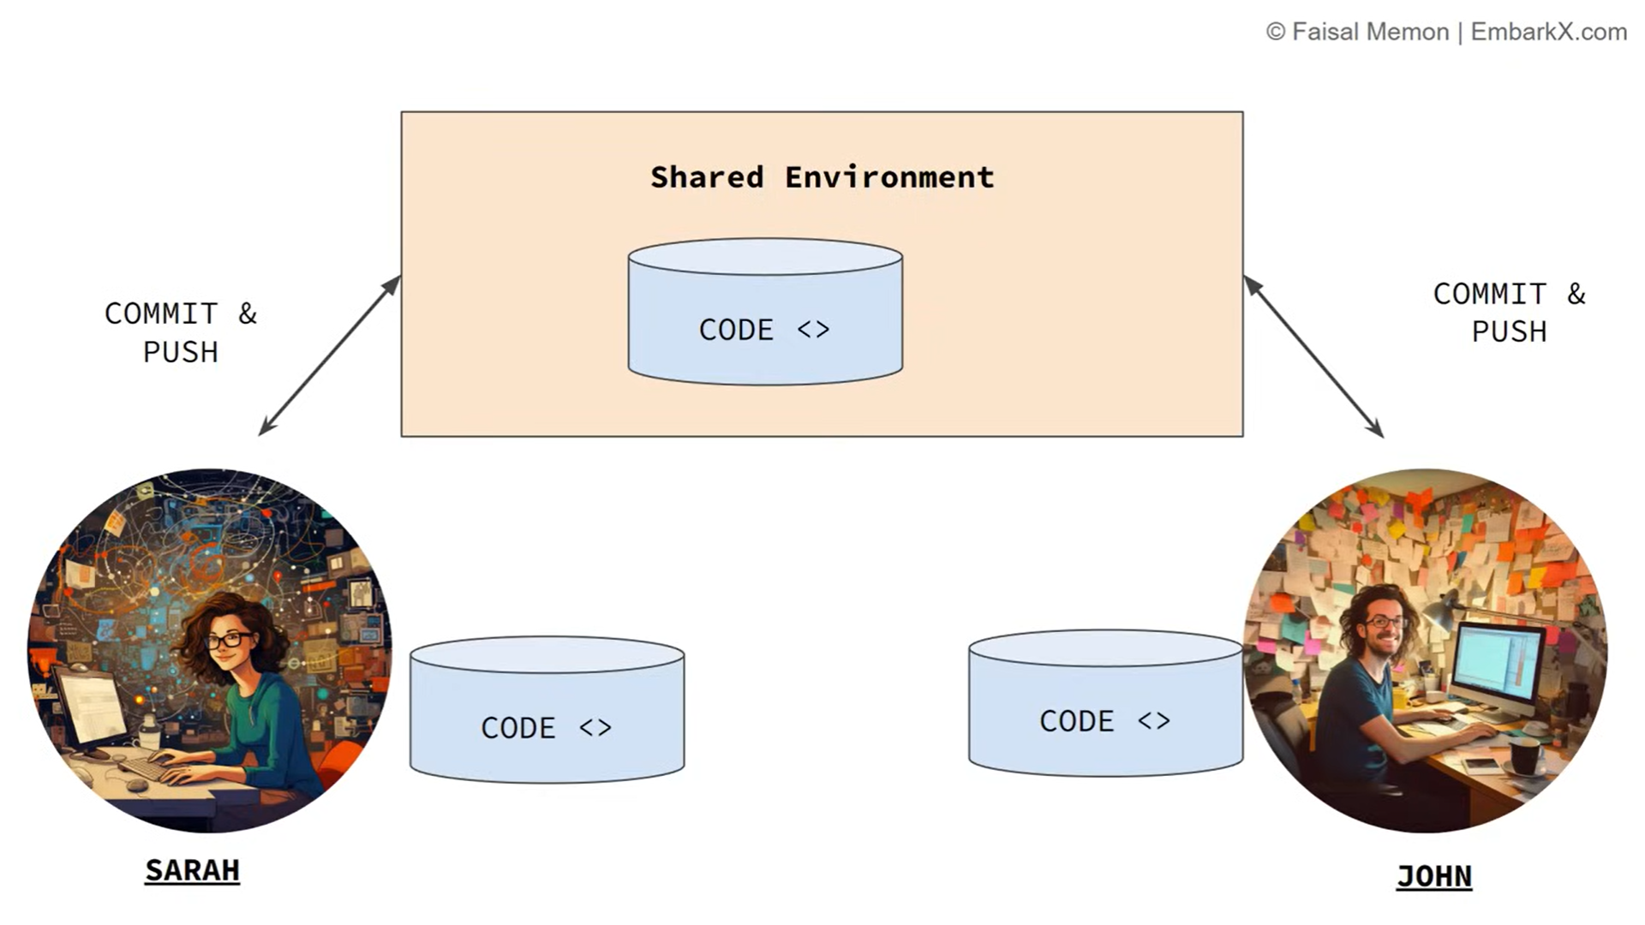
How?
Now, isolated container Is shared between the team and this container has all the required item to run the application.

Slide 20
What Docker solves?
Dependency Management.
Compatibility issues.
Environmental inconsistency.

Slide 21
What is Docker?
Docker is an open-source platform that allows you to automate the deployment, scaling and management of applications using containerization.

Slide 22
What is Containerization?
lightweight virtualization technology
package an application along with its dependencies that is needed for an application to run

Slide 23
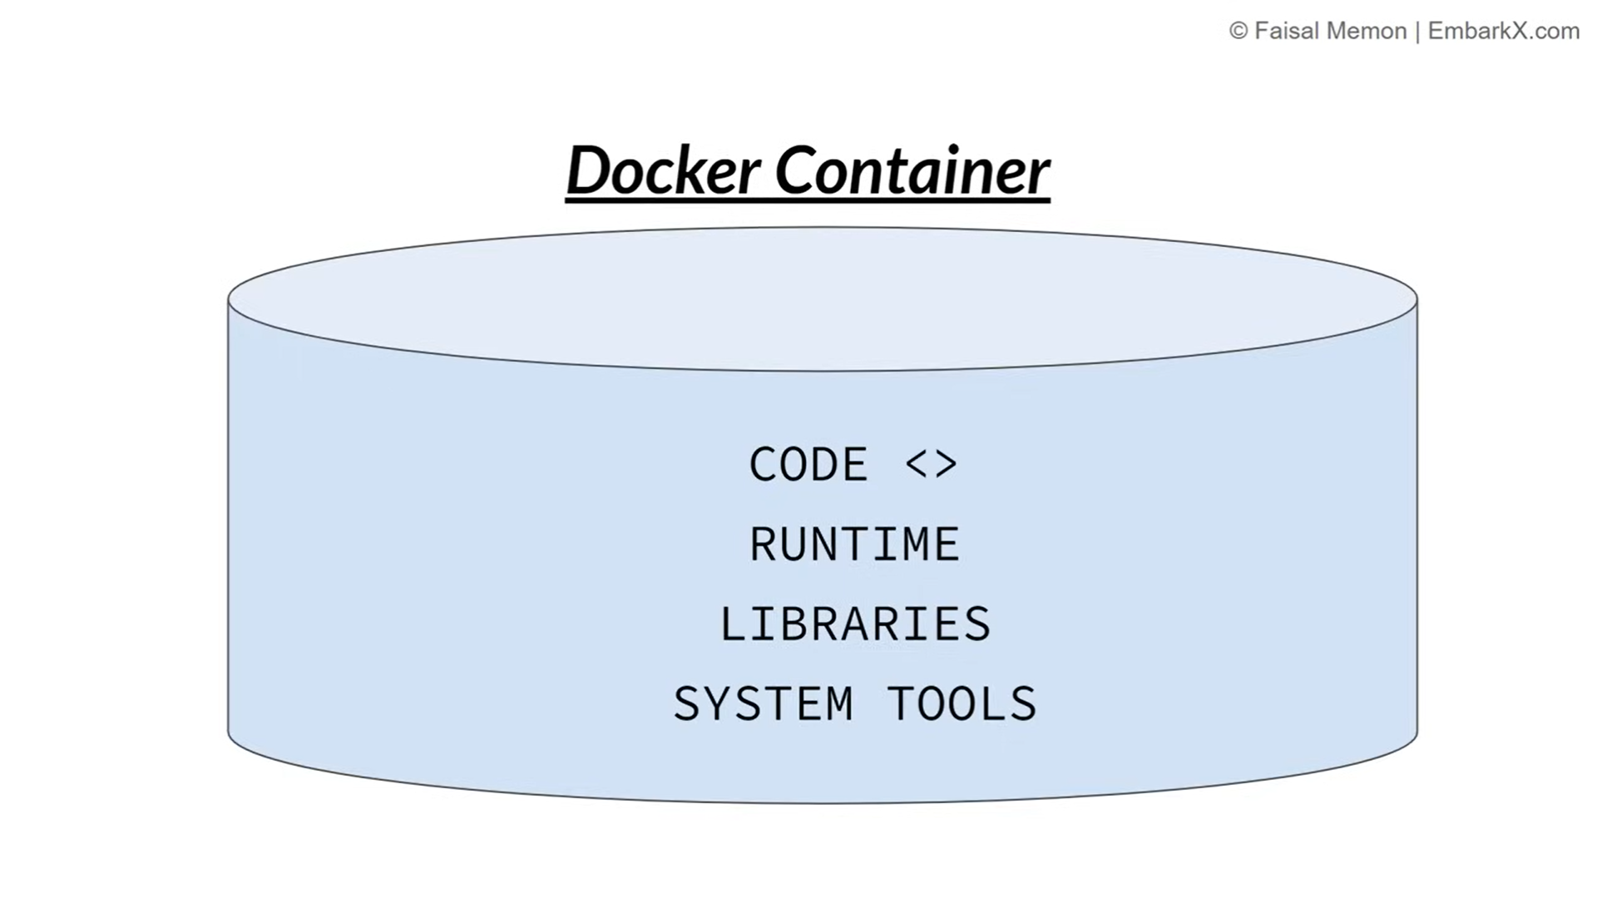
Docker Container

Slide 24
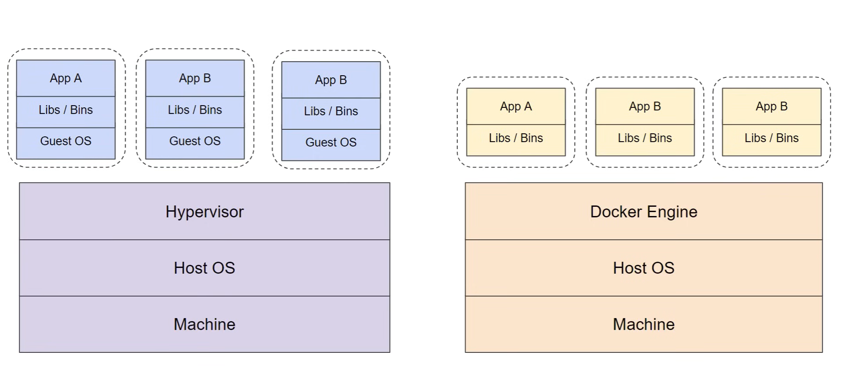
Docker over VM’s

Slide 25
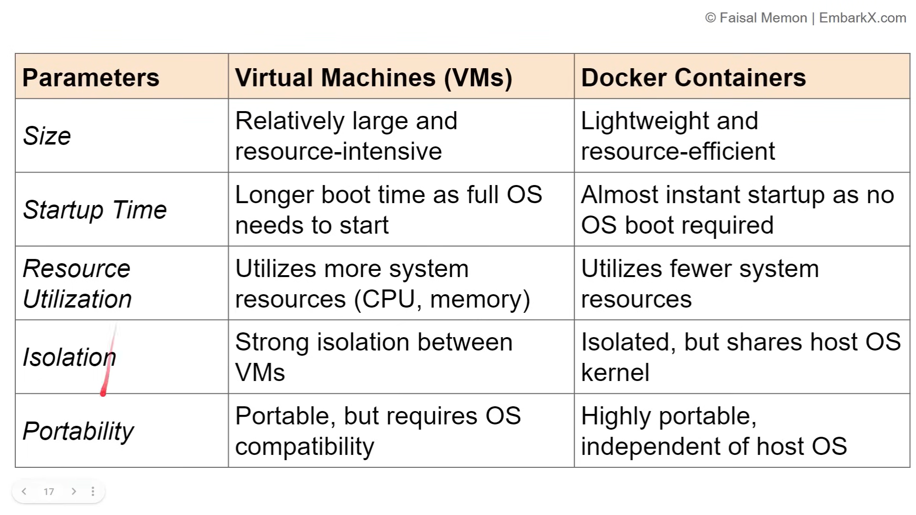
Docker over VM’s

Slide 26
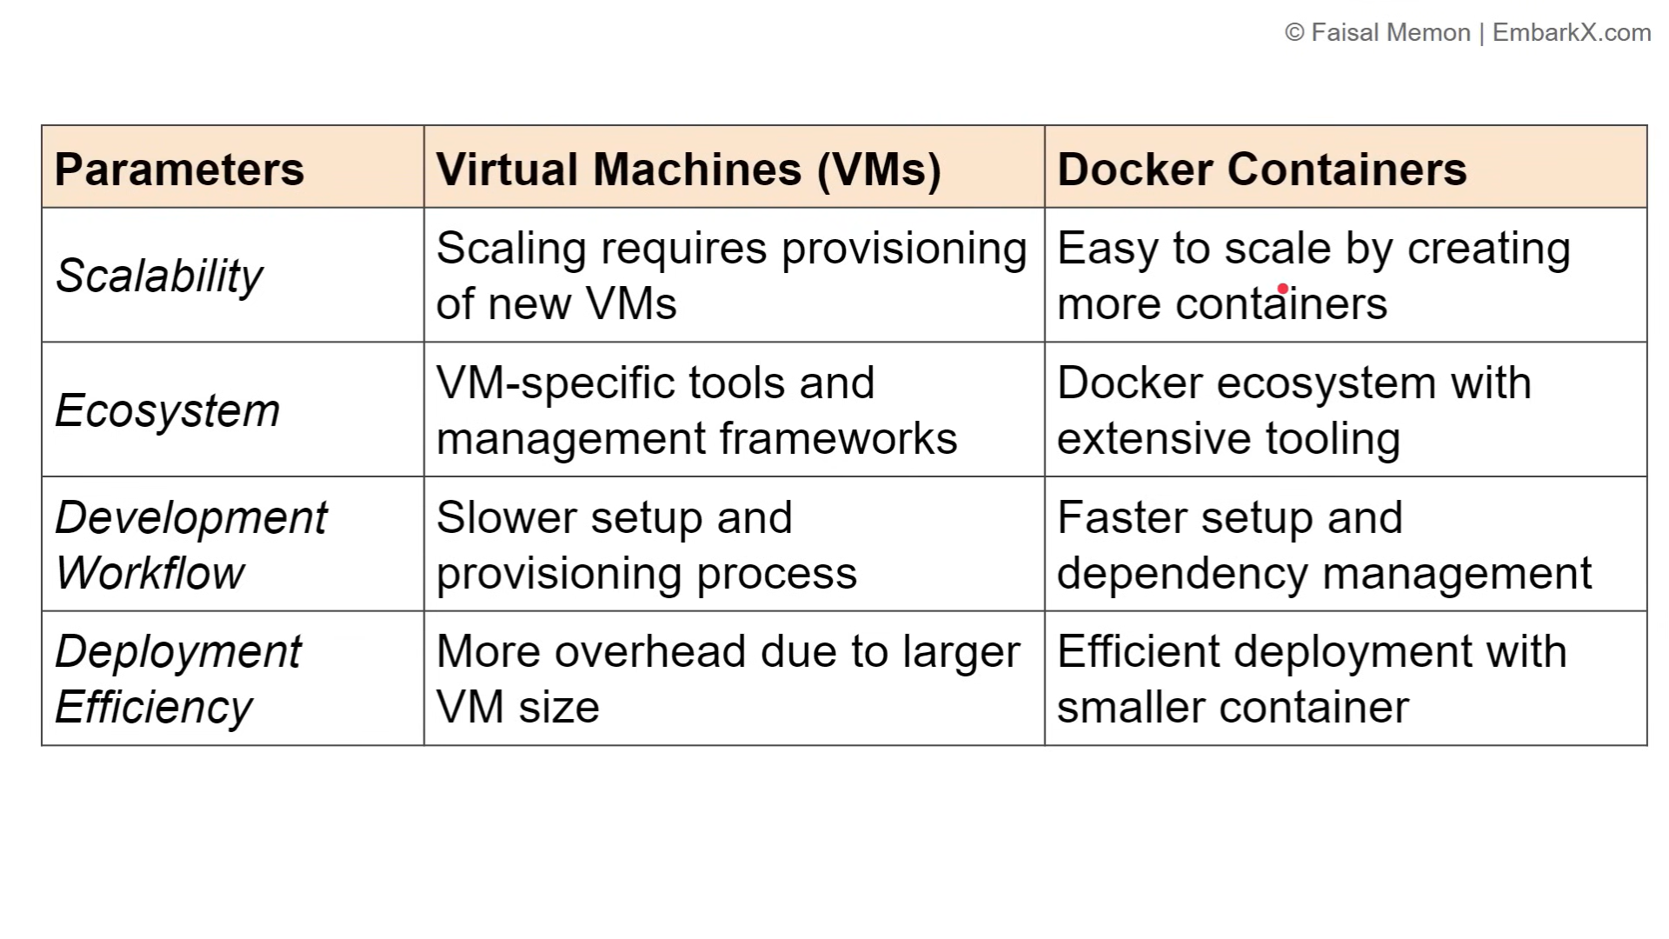
Docker over VM’s

Slide 27
Docker Architecture

Slide 28
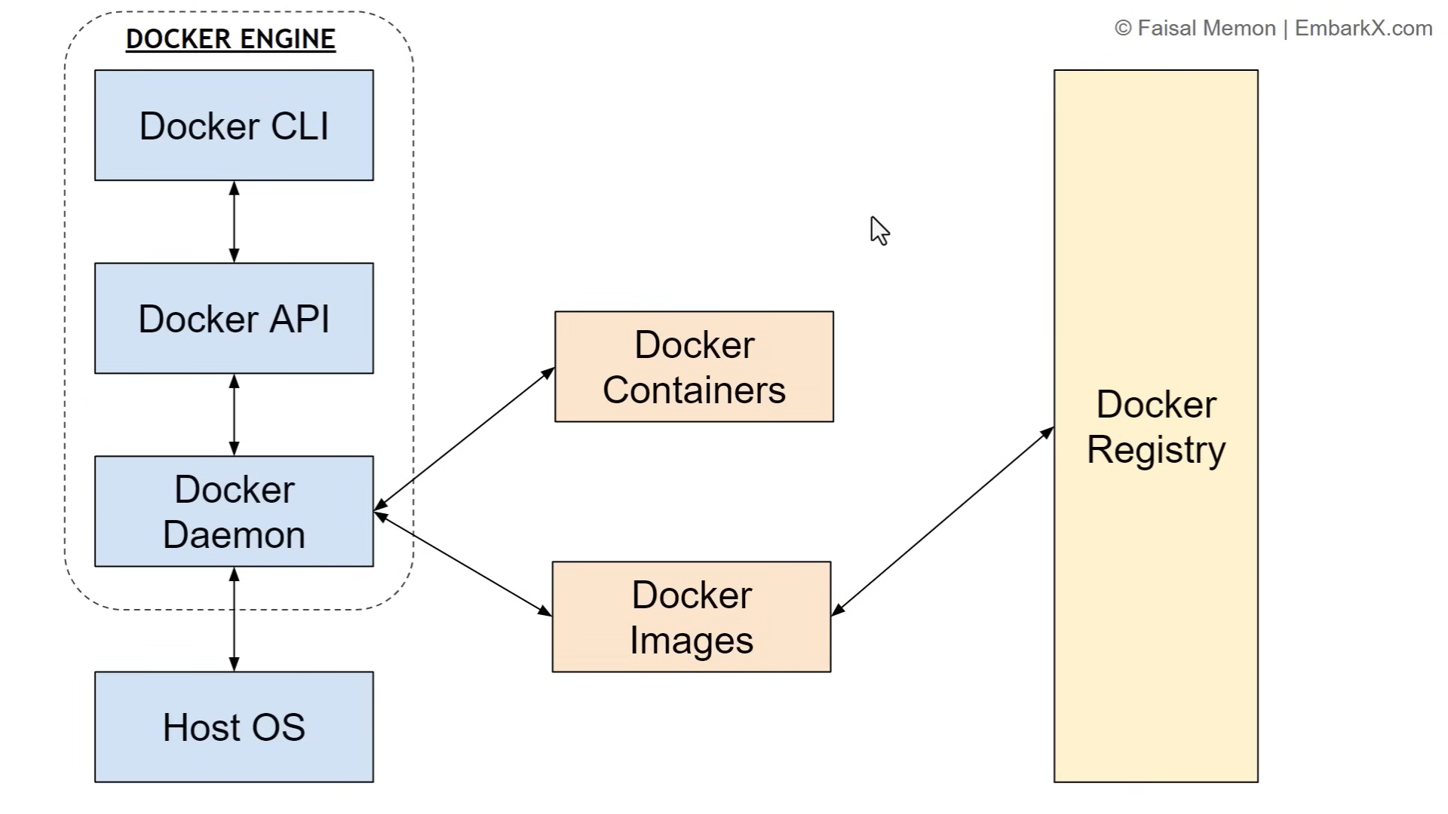

Slide 29
Docker Engine
It contains:
1. Docker CLI
2. Docker API
3. Docker Daemon

Slide 30
Docker Engine
Docker CLI
It’s a client that allows users to interact with Docker
It is used to communicate with the Docker.
It will interact with Docker Daemon.

Slide 31
Docker Engine
Docker Daemon
Runs on Host OS.
Responsible for building docker images & managing containers.

Slide 32
Docker Images
Blueprint for creating a container.
From one image we can create multiple image.
Templates that define the container and dependencies
Image are base on which container is build.

Slide 33
Docker Containers
Light weight
Running instance of Docker image.
Dockerfile
Instruction to build a Docker Image.
Docker Hub
Registry that has the vast collection of Docker images.

Slide 34
Docker Registry
It stores docker images.
Images can be public or private.
Repo of all the images.

Slide 35
Docker Registry

Slide 36
Docker Registry
Store docker images with different version.
Importance of Docker Registry
Centralized Resource.
Easy Versioning.
Share your Docker Image.

Slide 37
Available Docker Registry
https://hub.docker.com
Default registry used by Docker CLI and most of the docker tool.
https://aws.amazon.com/ecr/
https://cloud.google.com/artifact-registry
https://azure.Microsoft.com/en-in/product/container-registry
https://quay.io

Slide 38
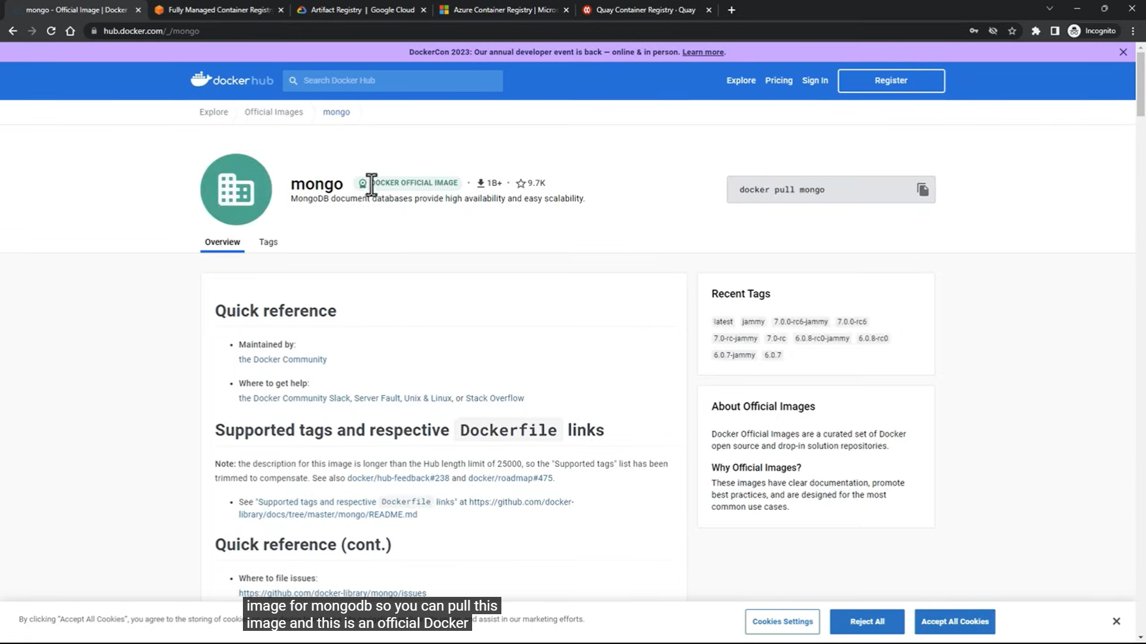
Available Docker Registry
Mongo image (https://hub.docker.com)

Slide 39
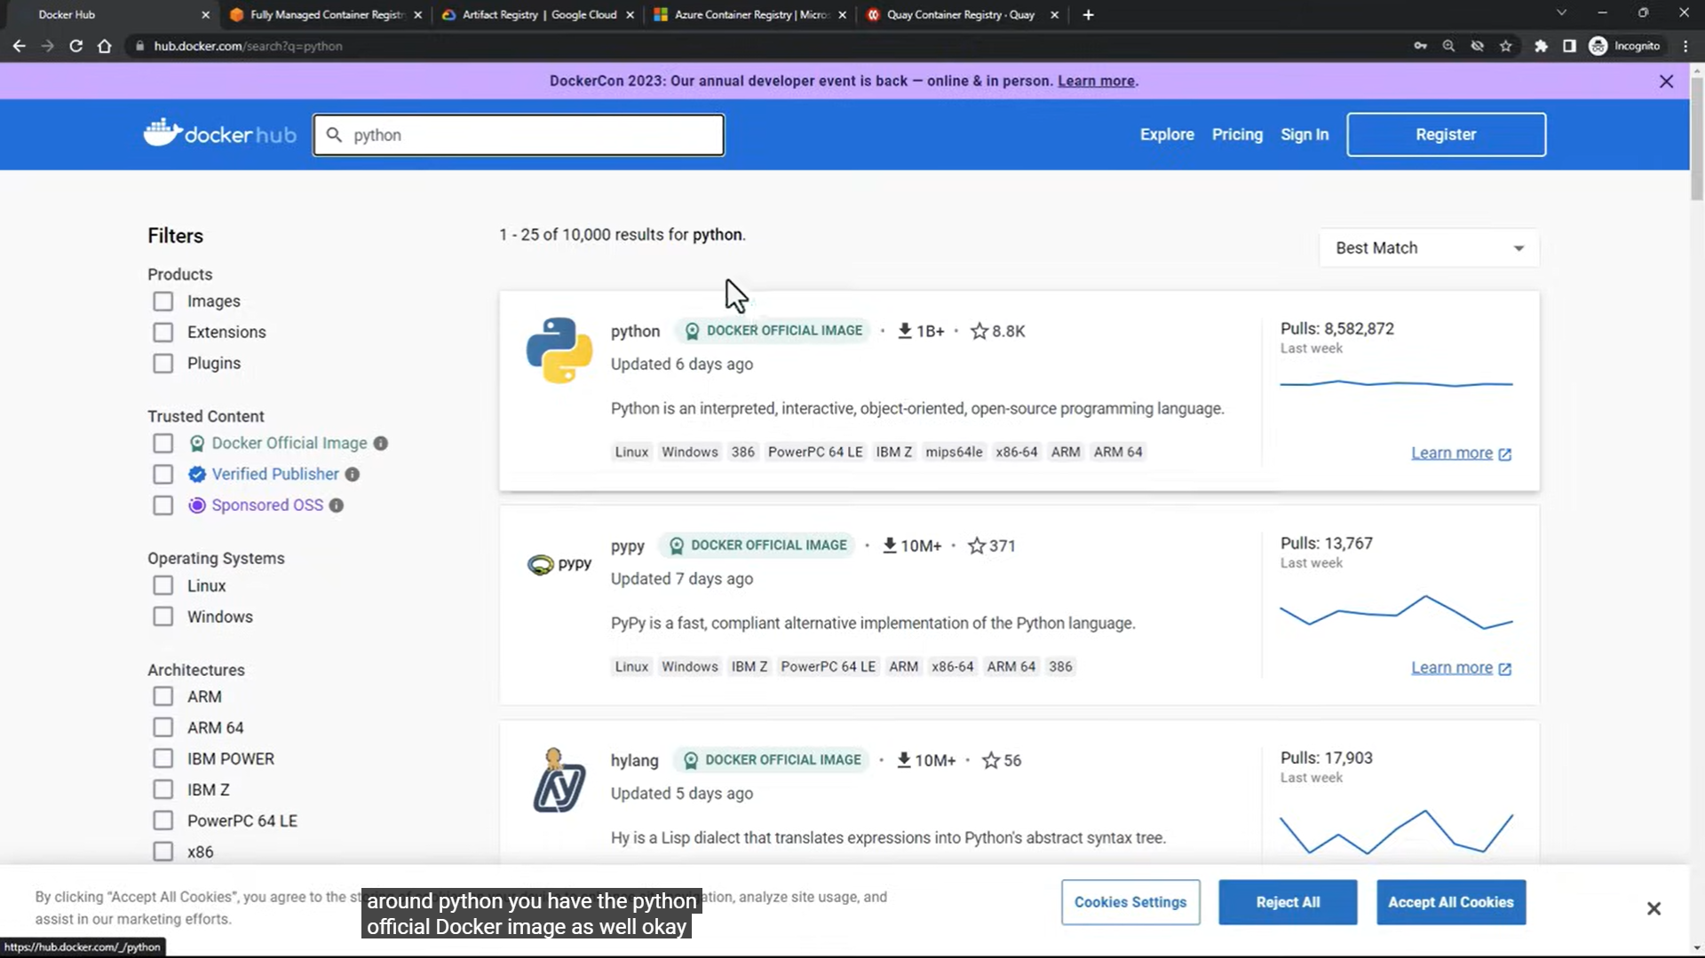
Available Docker Registry
python image (https://hub.docker.com)

Slide 40
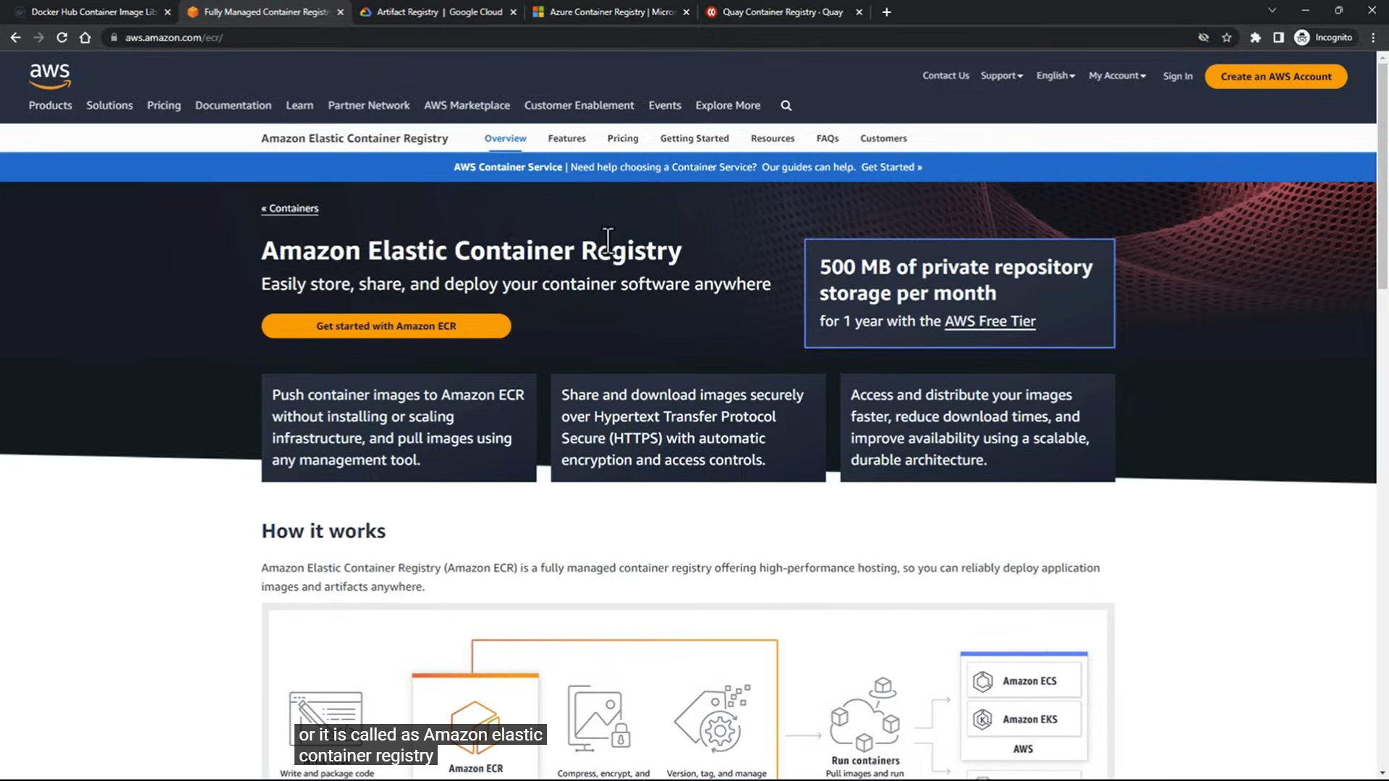
Available Docker Registry
(https://aws.amazon.com/ecr/)

Slide 41
Steps to create container from Docker Image

Slide 42
How to create container from Docker Hub?
Open browser and open Docker Hub after that search images what you have to download and make the container

Slide 43
How to create container from Docker Hub?
There are 2 options:
Pull image from Docker hub and then create container.
Direct use Docker run command to create container.

Slide 44
Steps to create container from Docker Hub?
To create container with container name and port
# docker run –it –name bhuvi –p 80:80 nginx:latest
Name of container
Port for outside access
Image name on docker hub

Slide 45
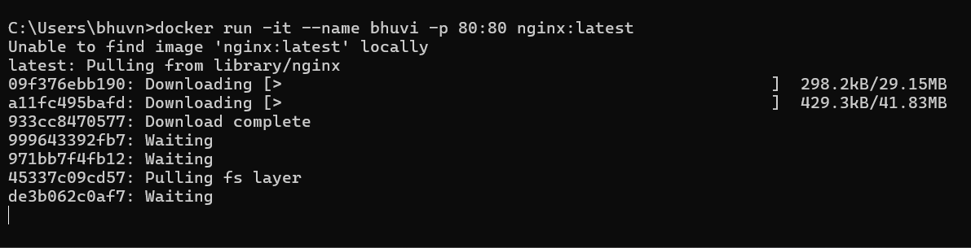
Steps to create container from Docker Hub?
To create container with container name and port

Slide 46
Steps to create container from Docker Hub?
Check that container is available or not
# docker ps -a

Slide 47
Steps to create container from Docker Hub?
To start container
# docker run bhuvi

Slide 48
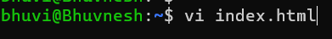
Steps to create container from Docker Hub?
Create index.html file
# vi index.html

Slide 49
Steps to create container from Docker Hub?
Copy index.html and paste it in nginx directory
# docker cp index.html bhuvi:/usr/share/nginx/html/

Slide 50
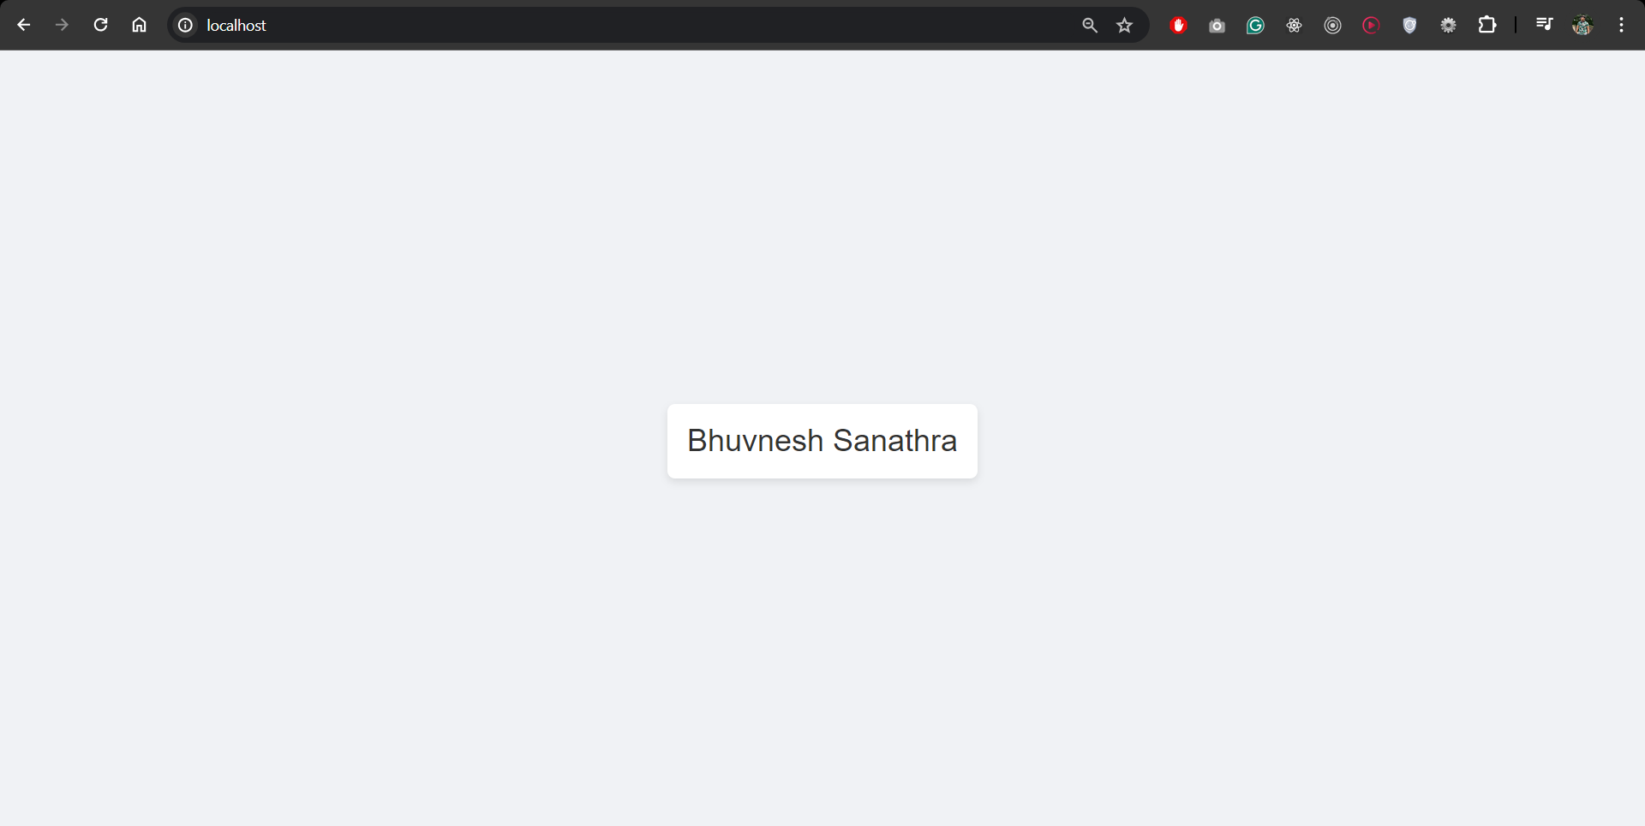
Steps to create container from Docker Hub?
Run in localhost on port 80
localhost:80

Slide 51
Using images from Docker Hub

Slide 52
How to Use of existing images from Docker Hub ?
I took the example of MongoDB image from docker hub

Slide 53
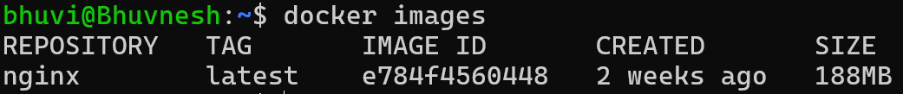
Steps to Use of existing images from Docker Hub ?
Check the docker images
# docker images

Slide 54
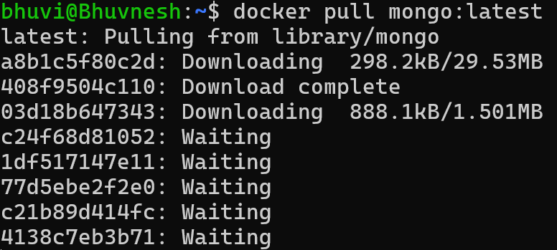
Steps to Use of existing images from Docker Hub ?
Pull the mongoDB image
# docker pull mongo:latest

Slide 55
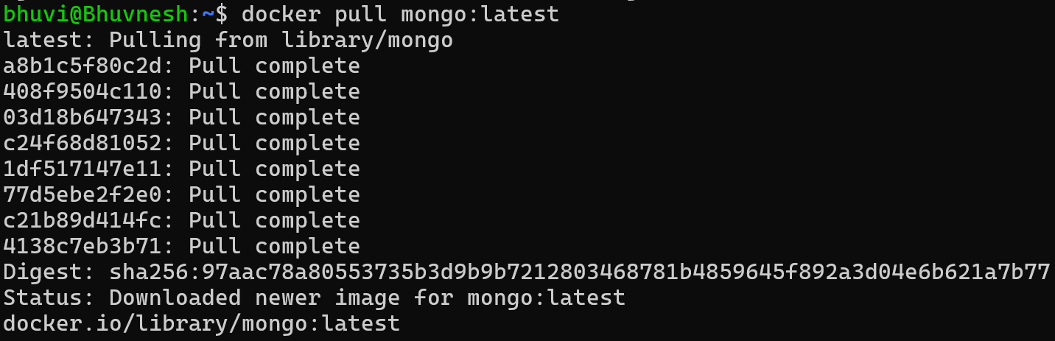
Steps to Use of existing images from Docker Hub ?

Slide 56
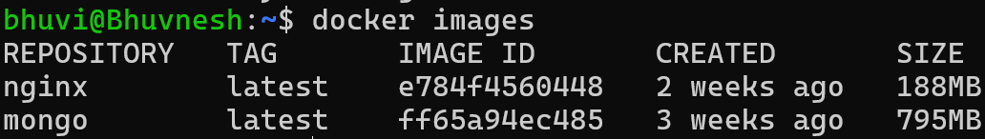
Steps to Use of existing images from Docker Hub ?
Check the docker images
# docker images

Slide 57
Steps to Use of existing images from Docker Hub ?
Make directory inside root folder
# mkdir mongoDB-bhuvi
Change directory
# cd mongoDB-bhuvi

Slide 58
Steps to Use of existing images from Docker Hub ?
Run the image inside the folder
# docker run –d –p 2717:27017 –v ~/mongoDB-bhuvi:/data/db –name bhuvimongo mongo:latest
-d -> run in background
-p -> bind the port
-v -> Volume
--name -> name of the image

Slide 59
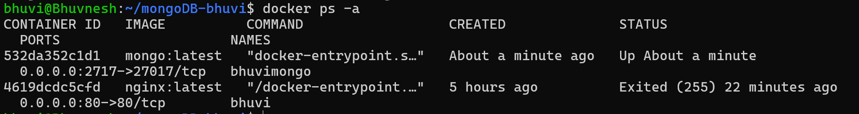
Steps to Use of existing images from Docker Hub ?
Container created check the container
# docker ps -a

Slide 60
Steps to Use of existing images from Docker Hub ?
Go inside container
# docker exec –it bhuvimongo bash

Slide 61
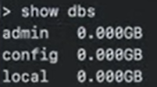
Steps to Use of existing images from Docker Hub ?
Go inside container
# docker exec –it bhuvimongo bash

Slide 62
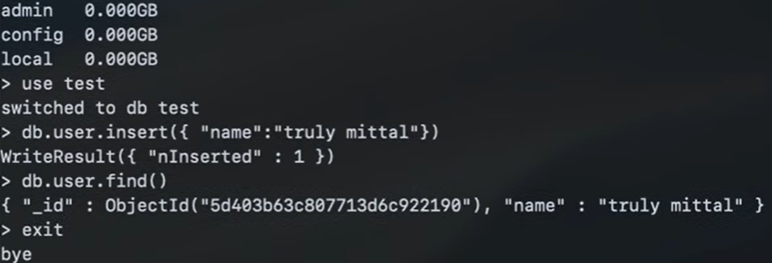
Steps to Use of existing images from Docker Hub ?

Slide 63
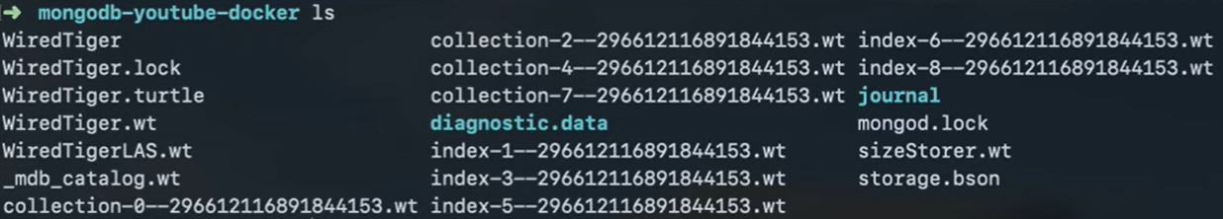
Steps to Use of existing images from Docker Hub ?

Slide 64
Thank You

